Slide 1
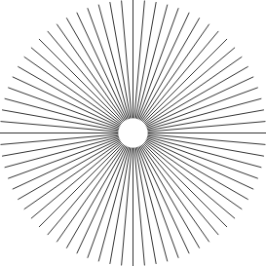

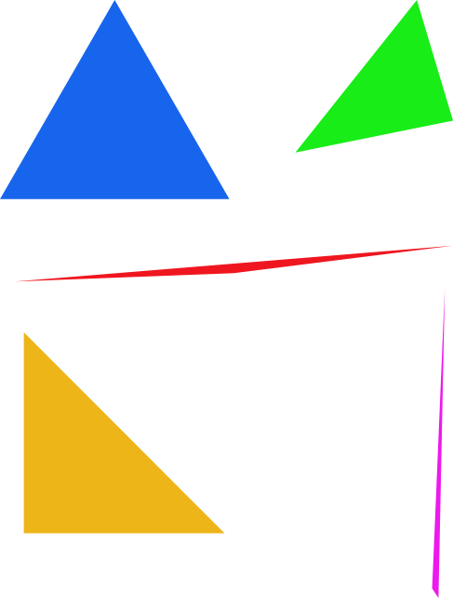
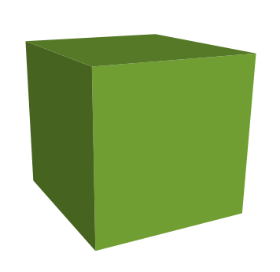

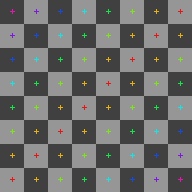
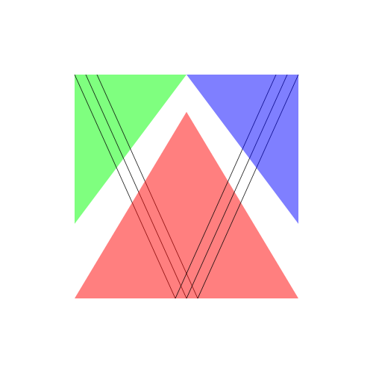
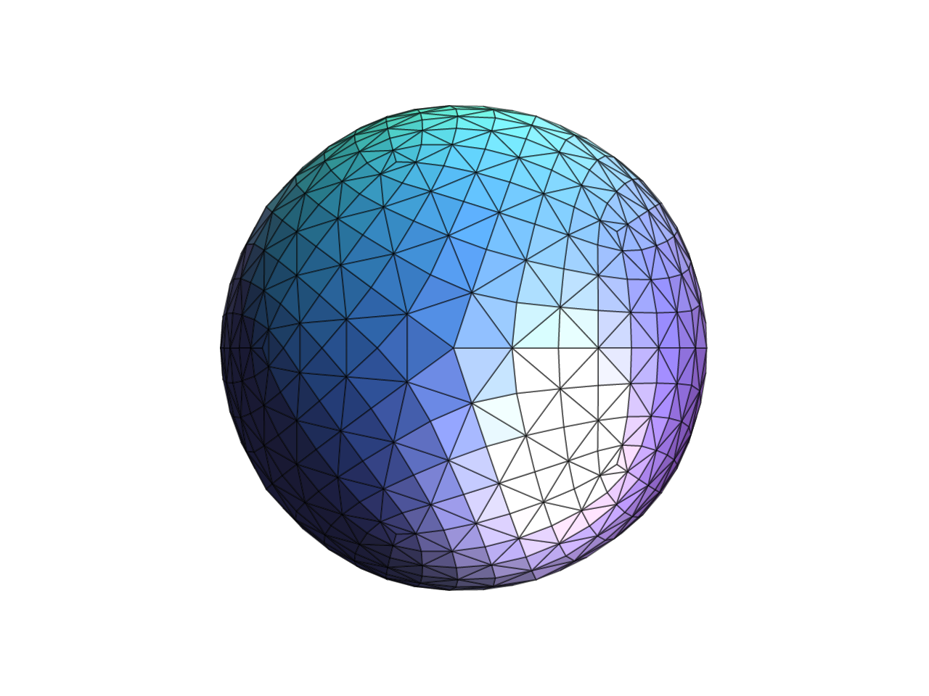
DrawSVG
Visualize Things on Your Screen!
Notes:
Hi everyone, this is your first major programming assignment, out of the 4 assignment we have for Computer Graphics.This assignment will cover the basics of rasterization pipeline. It is a good introduction to how the rest of the major coding assignments will go. Please start early, and reach out for any help that you need.

Slide 2
DrawSVG
Visualize Things on Your Screen!
Week 1
Due: 02/09
Week 2
Due: 02/16
Notes:
Most labs will be completed over a time frame of 2 weeks, where you have to complete the first half in a week and the rest in the next week. Typically we will have a checkpoint at the end of the first week. So for this lab, checkpoint is due on the 9th, and then the rest of the lab is due on the 16th.

Slide 3
SVG Rasterizer
Notes:
In this assignment, we are making our own SVG rasterizer.

Slide 4
What is a SVG file?
Scalable Vector Graphic
Notes:
First and foremost, let’s understand what are SVG files. You might have heard of it, or seen it as an extension, dot svg, for some images you saved on your computer.
SVG is an abbreviation for Scalable Vector Graphic. So there are 2 parts we want to understand.
First, what does it mean for an image to be Scalable
Second, what are Vector Graphics.

Slide 5
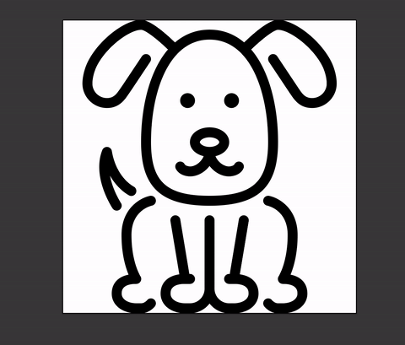
Scalable
Notes:
Scalable means no matter how we much we zoom in, we still get perfect edges. There is no sign of aliasing. This is why people love to use SVG for logos. As you can imagine, logos have to look perfect on both small or large screens, or print mediums such as posters of different dimensions, etc.

Slide 6

Raster images does not scale nicely!
Notes:
Here is an example of an image that does NOT scale well. It is literally the same icon as the previous one, but I saved it as a png file, so now it’s a raster image. Observe what happens when we zoom in. You see the jagged edges, which are evidence of aliasing happening.

Slide 7
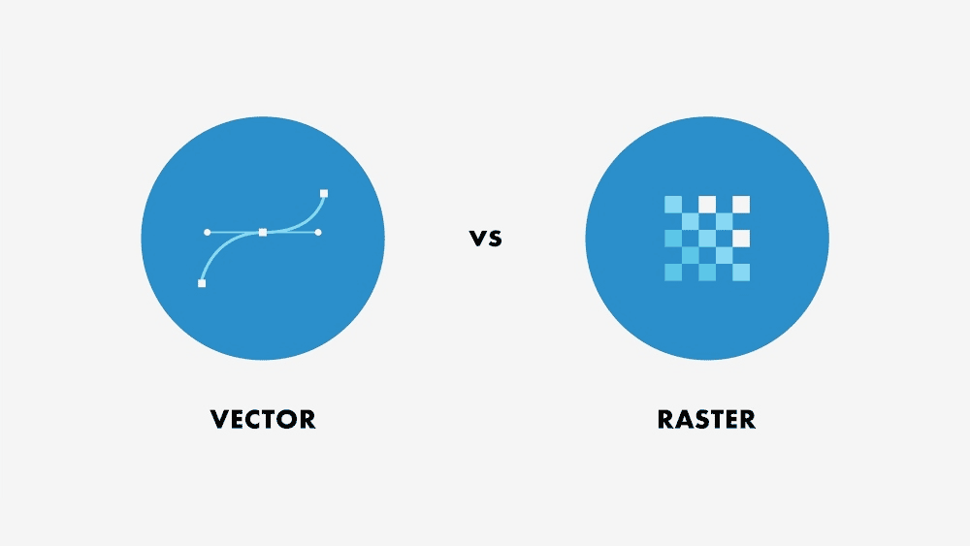
2. Vector Graphic vs Raster Graphic
Notes:
Now let’s look at what vector graphic means. Vector graphics are images drawn with geometries, aka mathematical formulas. Whereas raster graphics are consisted of grid of pixels that each has a rgba color value. To personify them, we can say that vector graphic thinks in terms of individual shapes such as rectangles, circles, lines, etc, whereas raster graphic thinks in terms of each individual pixels.

Slide 8
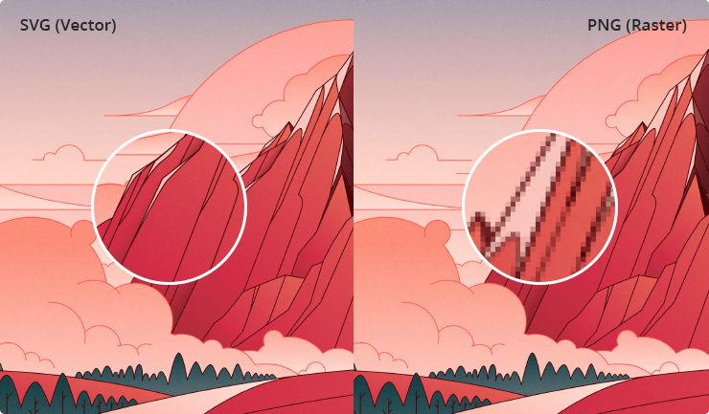
Notes:
So at this point, you might ask, okay, if raster images do not scale well, and thinking in terms of formulas versus pixels literally means nothing to me right now, why don’t we just use vector images for everything?

Slide 9

Q: Why raster?
Notes:
The answer is that with raster graphic, we can do more fancy editing on the image. For example, the blurring effect you see here can only be performed on a raster image. Therefore a common practice in design and art is to create designs first in vector because we are not sure of the final dimensions yet, and at the final stages where we want to spice up the image with visual effects, we go ahead and raster the vector image.

Slide 10
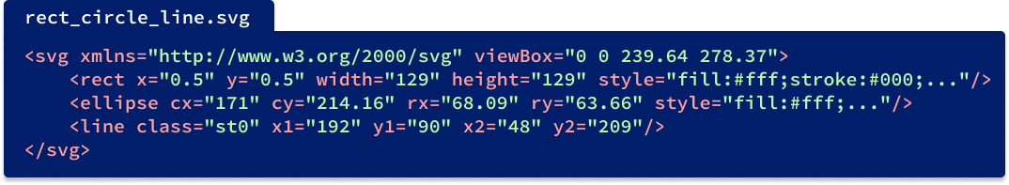
SVG files are not black boxes!
Notes:
This is what you would see when you open up a svg file in any text editor. This is what it means to “think in terms of shapes”. Svg files basically keep track of the collection of shapes in the image. Here you see rect for rectangle, ellipse and line for ellipse and lines. For each shape, we have specifications of how it sits on the image. For example, the line has endpoints at (192, 90) and (48, 209). These are the parameters we will work with as we render these shapes on a grid of pixels.

Slide 11
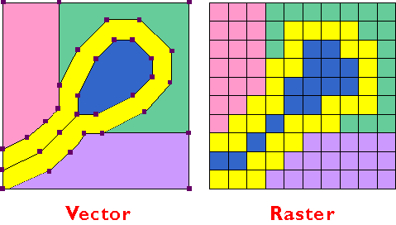
Goal of DrawSVG Lab:
vector
raster
Notes:
So the word rasterization corresponds to the process of converting a vector image into a raster image. Now we are ready to dive into the specifics of the assignment.

Slide 12
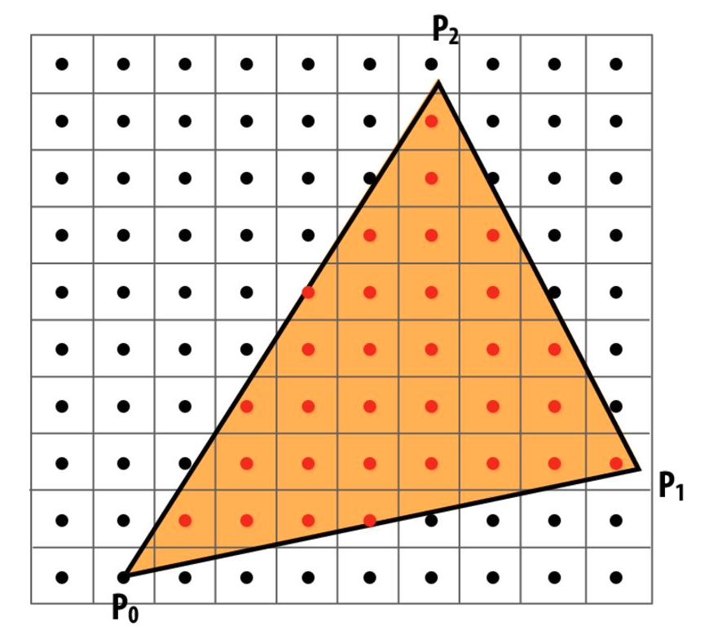

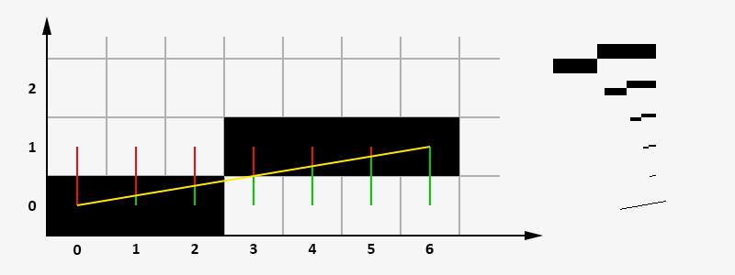
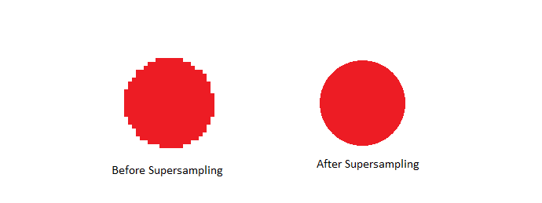
Overview of Tasks (Part I)
Task 1: Hardware Renderer
Task 3: Drawing Triangles
Task 2: Drawing Lines
Task 4: Anti-Aliasing Using Supersampling
Notes:
Task 1 - finish implementing the hardware renderer parts
Task 2 - draw lines in the software renderer
Task 3 - draw triangles in the software renderer
Task 4 - Try to make the image smoother with supersampling (changing sample rate + changing screen size)

Slide 13
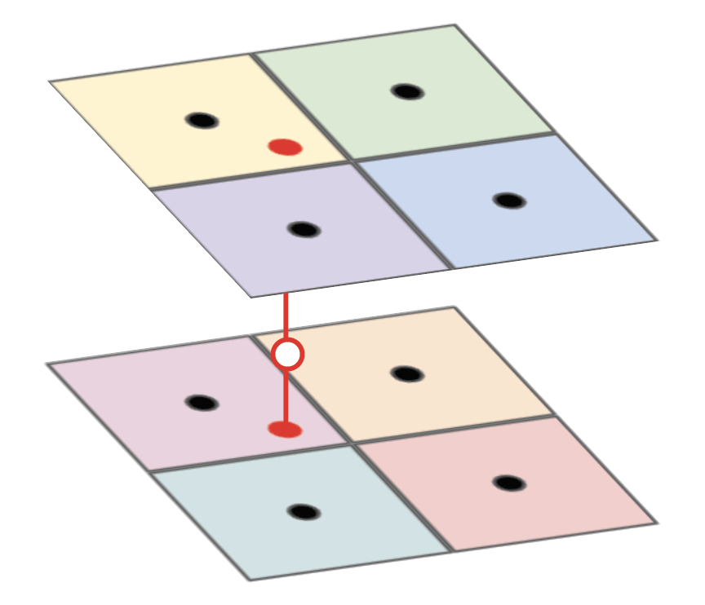
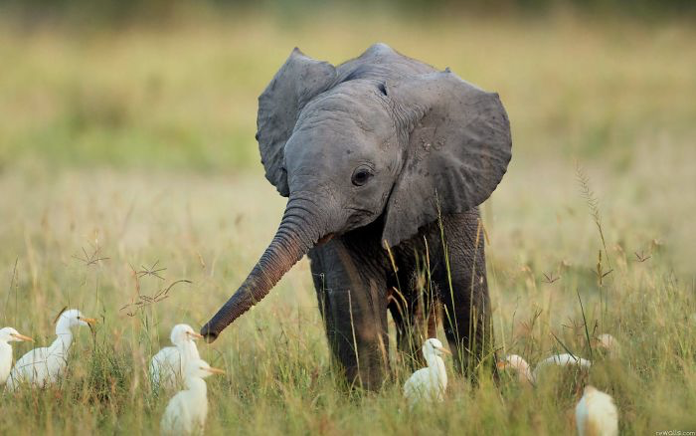
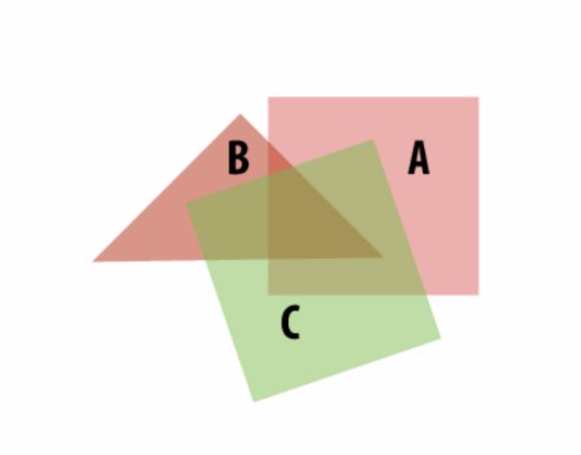
Overview of Tasks (Part II)
Task 5: Implementing Modeling and Viewing Transforms
Task 7: Anti-Aliasing Image Elements Using Trilinear Filtering
Task 6: Drawing Scaled Images
Task 8: Alpha Compositing
Notes:
Task 5 - implement transformation hierarchy and zoom / pan
Task 6 - drawing scaled images with textures
Task 7 - anti aliasing part 6 with trilinear
Task 8 - alpha compositing to draw semi-transparent images

Slide 14
Task 1: Hardware Renderer
Task 2: Drawing Lines
Task 3: Drawing Triangles
Task 4: Anti-Aliasing Using Supersampling
Task 5: Implementing Modeling and Viewing Transforms
Task 6: Drawing Scaled Images
Task 7: Anti-Aliasing Image Elements Using Trilinear Filtering
Task 8: Alpha Compositing
Notes:
Task 9 - draw something (be creative !)

Slide 15
Task 1: Hardware Renderer (GPU)
Implement the following functions:
void rasterize_point(float x, float y, Color color);
void rasterize_line(float x0, float y0,
float x1, float y1,
Color color);
void rasterize_triangle(float x0, float y0,
float x1, float y1,
float x2, float y2, Color color);
functions can be found in hardware/hardware_renderer.cpp
Notes:
You first task will be implementing rasterize point, line, and triangle in the hardware_renderer file. These functions are what will make the images for the hardware renderer show up. So read up on the documentation on how to switch between hardware and software renderers, and hint it’s by pressing H.

Slide 16
Task 1: Hardware Renderer (GPU)
Implement the following functions:
What your code should look like:
void rasterize_point(float x, float y, Color color);
void rasterize_line(float x0, float y0,
float x1, float y1,
Color color);
void rasterize_primitive() {
glBegin(GLenum mode);
...
glEnd();
}
void rasterize_triangle(float x0, float y0,
float x1, float y1,
float x2, float y2, Color color);
functions can be found in hardware/hardware_renderer.cpp
Notes:
We won’t be using openGL other than this, but the general idea is to structure each of the functions like the right
glBegin and glEnd will basically define how vertices made inside of this will be interpreted - I would recommend taking a look at GL_POINTS, GL_LINES and GL_TRIANGLES

Slide 17
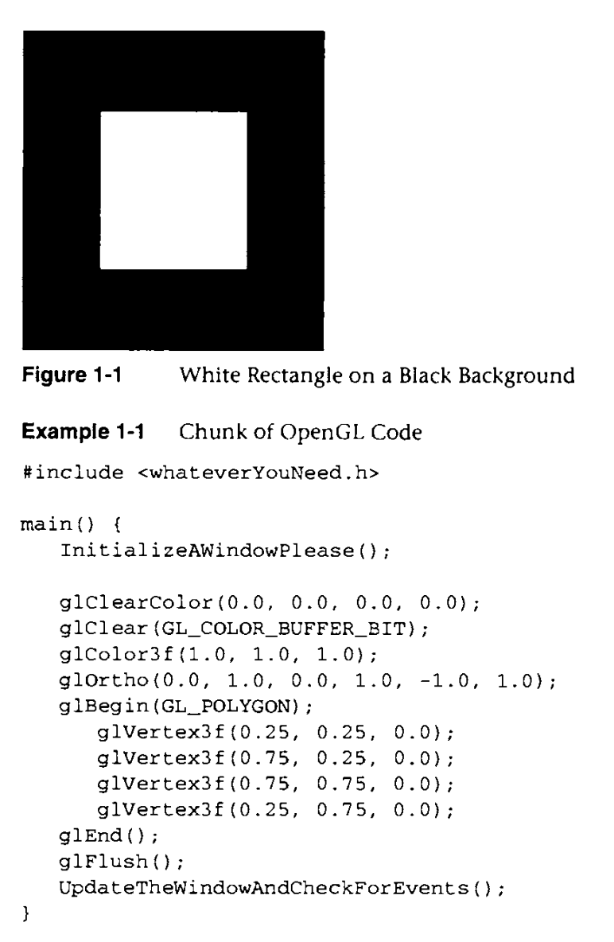
Task 1: Hardware Renderer (GPU)
OpenGL calls:
GL_POINTS
GL_LINES
GL_TRIANGLES
void glBegin(GLenum mode);
void glEnd(void);
glBegin and glEnd interpret the vertices presented between glBegin and glEnd as inputs to different primitives (e.g. triangle, line, etc.)
void glVertex2f(GLfloat x, GLfloat y);
void glColor4f(GLfloat red, GLfloat green, GLfloat blue, GLfloat alpha);
Notes:
Some helpful functions include glVertex2, glColor4f.
On the right hand side, there is a helpful nice snippet of OpenGL code. Your code should look similar, and honestly, much simpler. And another hint, your cdoe should look similar to specifically the lines inside the red rectangle on the right.

Slide 18
Overview of DrawSVG Software Renderer
SVG File
Screen Output
DrawSVG Software Renderer (CPU)
draw_elements
(rasterize functions)
resolve
(target resolution)
display_pixels
(render to screen)
Context Setup
Sample Buffer
Target Buffer
Task 2: rasterize line
Task 3: rasterize triangle
Task 5: transforms
Task 6-7: texture sampling
Task 4: supersampling support
Task 8: alpha blending
Notes:
There are two main data structures that you will have to deal with throughout this lab, namely the sample buffer and the target buffer. Both technically represent that image that you’re trying to render
To explain what the sample and target buffers are.
SVG file -> context setup -> draw stuff (tasks) -> we now have a sample buffer -> resolve to get the correctly sized image in our target buffer -> display the pixels -> we can see the output
Sample - full resolution image
Target - what we will display on the screen

Slide 19
Overview of DrawSVG Software Renderer
SVG File
Screen Output
“full resolution image”
“target render image”
DrawSVG Software Renderer (CPU)
draw_elements
(rasterize functions)
resolve
(target resolution)
display_pixels
(render to screen)
Context Setup
Sample Buffer
Target Buffer
Task 2: rasterize line
Task 3: rasterize triangle
Task 5: transforms
Task 6-7: texture sampling
Task 4: supersampling support
Task 8: alpha blending
Notes:
There are two main data structures that you will have to deal with throughout this lab, namely the sample buffer and the target buffer. Both technically represent that image that you’re trying to render
To explain what the sample and target buffers are.
SVG file -> context setup -> draw stuff (tasks) -> we now have a sample buffer -> resolve to get the correctly sized image in our target buffer -> display the pixels -> we can see the output

Slide 20
Overview of DrawSVG Software Renderer
Sample Buffer / Target Buffer
rgba rgba rgba rgba….
SVG File
Screen Output
“full resolution image”
“target render image”
DrawSVG Software Renderer (CPU)
draw_elements
(rasterize functions)
resolve
(target resolution)
display_pixels
(render to screen)
Context Setup
Sample Buffer
Target Buffer
Task 2: rasterize line
Task 3: rasterize triangle
Task 5: transforms
Task 6-7: texture sampling
Task 4: supersampling support
Task 8: alpha blending
Notes:
There are two main data structures that you will have to deal with throughout this lab, namely the sample buffer and the target buffer. Both technically represent that image that you’re trying to render
To explain what the sample and target buffers are.
SVG file -> context setup -> draw stuff (tasks) -> we now have a sample buffer -> resolve to get the correctly sized image in our target buffer -> display the pixels -> we can see the output

Slide 21
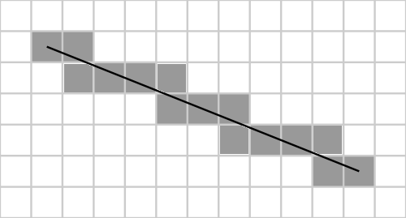
Task 2: Drawing Lines
void rasterize_line(float x0, float y0,
float x1, float y1,
Color color);
Notes:
Lecture 1 - drawing lines
For now, we’ll assume we our slope is between 0 and 1.
This implies that we’ll be checking at most 2 pixels for the line at each x coordinate.

Slide 22
Task 2: Drawing Lines
void rasterize_line(float x0, float y0,
float x1, float y1,
Color color);
Do I rasterize (x + 1, y + 1) or (x + 1, y)?
Notes:
Lecture 1 - drawing lines
For now, we’ll assume we our slope is between 0 and 1.
This implies that we’ll be checking at most 2 pixels for the line at each x coordinate.
We can check this with DDA (which will become bresenham)

Slide 23
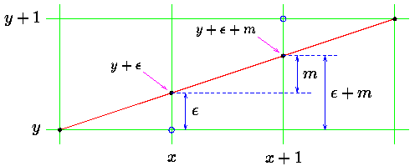
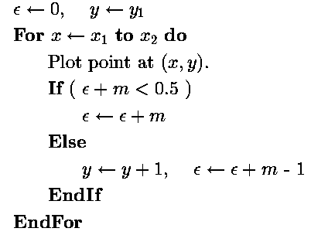
Task 2: Drawing Lines
Digital Differential Analyzer (DDA) Line Algorithm
y + 0.5
Notes:
So DDA - the idea is that we’ll keep a counter for the height we’re currently at and at each x coordinate, we’ll increase the height by the slope because of math.
From here, we check the height to see which corner point we should stay at.

Slide 24
Task 2: Drawing Lines
Digital Differential Analyzer (DDA) Line Algorithm
closer to y
y + 0.5
Notes:
So DDA - the idea is that we’ll keep a counter for the height we’re currently at and at each x coordinate, we’ll increase the height by the slope because of math.
From here, we check the height to see which corner point we should stay at.

Slide 25
Task 2: Drawing Lines
Digital Differential Analyzer (DDA) Line Algorithm
closer to y +1
closer to y
y + 0.5
Notes:
So DDA - the idea is that we’ll keep a counter for the height we’re currently at and at each x coordinate, we’ll increase the height by the slope because of math.
From here, we check the height to see which corner point we should stay at.

Slide 26
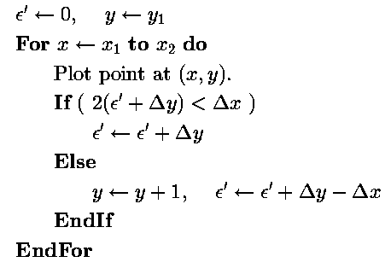
Task 2: Drawing Lines
Digital Differential Analyzer (DDA) Line Algorithm
Bresenham’s Line Algorithm
Multiply thru by 2Δx
*Uses only integer arithmetic, therefore much faster than DDA
Notes:
Floating arithmetic is slow compared to integer arithmetic, so we multiply everything by 2 \delta x (where \delta x is the denominator of the slope).

Slide 27
Task 2: Drawing Lines
Don’t forget to account for steep lines and negative slopes!
Hint: For steep lines, dy is a lot larger than dx. This results in lines that have pixels seemingly very far from each other. Can you somehow flip something in the algorithm to account for this?
y + 0.5
Notes:
We’re not restricted to just having a slope between 0 and 1 every time - think about how we would change our calculations to adjust for any slope

Slide 28
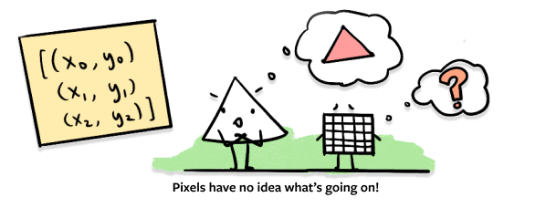
Task 3: Drawing Triangles
void rasterize_triangle(float x0, float y0,
float x1, float y1,
float x2, float y2,
Color color);

Slide 29
Task 3: Drawing Triangles
if AB x AP, BC x BP, and CA x CP have the same sign,
P is inside triangle ABC
Implement:
C
void rasterize_triangle(float x0, float y0,
float x1, float y1,
float x2, float y2,
Color color);
P
B
A
Notes:
In lecture, Keenan briefly went over the wedge product, which is a generalization of the cross product to all other dimensions.
Lecture 4 - drawing triangles and transformations
In 3D, the cross product A x B results in a vector C that is orthogonal to both A and B.
In 2D, the cross product A x B results in a pseudoscalar that determines whether or not B is to the right of A.
Note the directions!
Avoid checking every pixel in the image

Slide 30
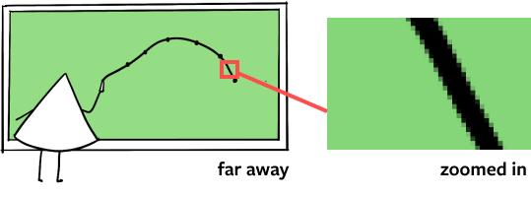
Task 4: Anti-Aliasing Using Supersampling
Notes:
Now we are going to tackle one of the most frustrating yet frequent occurrence we see in graphics — aliasing. As we’ve talked about in our introduction, when we raster an svg into raster image, we will have to deal with these ugly looking edges. Our solution is supersampling.

Slide 31
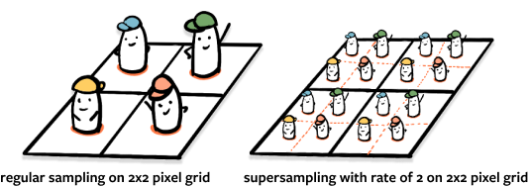
Task 4: Anti-Aliasing Using Supersampling
Notes:
The conceptual idea is that instead of taking one sample at the center of each pixel cell, instead, we take multiple samples. You can think of it as subdividing each pixel cell into n by n smaller cells given n is the sample rate, OR you can think of it as rendering a larger image of width times n and height times n. I like to think of samples as little agents who can offer me more information on what I should do with the pixel cell. So here you see two 2 by 2 pixel grids with regular sampling versus supersampling.

Slide 32
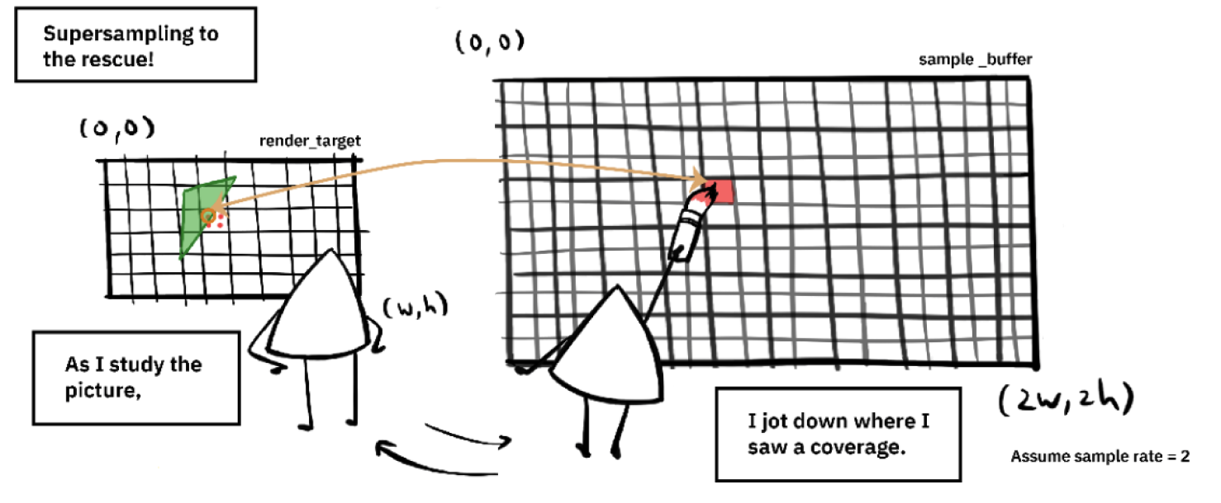
Perhaps define an array called sample_buffer 👀
Notes:
To put it more concretely, how you take a sample is by keeping another array (probably bigger than your render target by sample rate times sample rate), and instead of directly updating your render_target, you update your sample_buffer, and at the end, you merge all samples for each pixel cell into a final color.

Slide 33
Task 4: Anti-Aliasing Using Supersampling
Modify the following functions to support supersampling:
Called whenever user presses - or =
void set_sample_rate(size_t sample_rate);
TODO: Resize the sample_buffer
Called whenever user resizes application window
void set_render_target(unsigned char* render_target, size_t width, size_t height);
TODO: Resize the sample_buffer
void resolve(void);
Downsample from sample_buffer into render_target using a box filter
Notes:
Here are the three functions you will be writing.
Set_sample_rate is called when you press keys to increase or decrease samples/pixel
Set_render_target is called every time you resize your application window
With both of these functions, you will need to think about resizing the sample buffer
Resolve is an integral part of the pipeline, downsampling from the sample buffer to the target buffer. What that means is you want to loop over all the samples you took for that pixel, and combine them to get a final value for the pixel.
To clarify, if the sample rate is 1, you won’t need to do anything and you
Just need to copy the contents of the sample buffer into the target buffer.

Slide 34
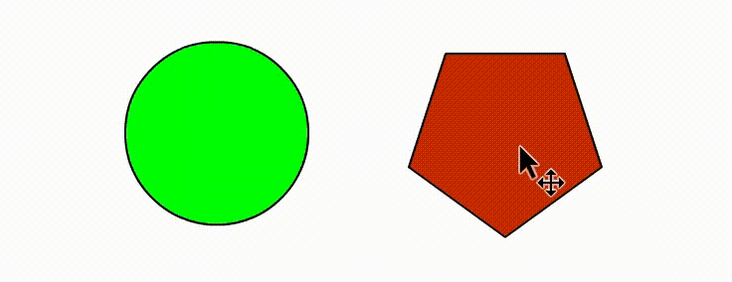
Task 5a: Implementing Modeling Transforms
SVGs are hierarchies of drawable elements. Each node of the hierarchies has its own transformation relative to its parent.
150px
Bowling Group (Root/Parent)
Bowler (Child)
Bowling Ball (Child)
50px
Child objects must recursively inherit transformations from their parents.
150px
Root node (highest in hierarchy) has a transformation relative to canvas space.
Modify (in a few lines of code):
void draw_element(SVGElement* element);
Where we now take into account the modeling transforms of each element and their parents.
Notes:
Lecture 5 transformations
At the moment, transforming the parent doesn’t affect the children - we want to change this to be similar to the gif
We’ll have to add a few lines of code in draw_element an draw_svg (look at the transform associated with an element)

Slide 35
Task 5b: Implementing Viewing Transforms
The viewport is defined by:
Modify (viewport.cpp):
centerX centerY vspan
void set_viewbox(float x, float y,
float span);
This function should construct a Matrix3x3 object that transforms the viewport area to normalized screen space.
The resulting matrix should be passed to set_viewbox(Matrix3x3 m);
Hint: Remember homogeneous coordinates!
(centerX, centerY)
vspan
hspan = aspectRatio * vspan
You are not given aspectRatio, nor do you need aspectRatio or hspan to solve this problem.
Notes:
This will account for panning the screen and zooming in and out.
Each time we do something ^, we’ll need to compute the matrix that transforms our new viewbox to normalized screen space

Slide 36
Task 5b: Implementing Viewing Transforms
Y-axis flipped
World Space
(origin 0,0)
vspan: infinite
When we scale vspan, we apply the same scale amount to hspan. Why?
Hint: go back a slide!
(0,0)
(200,150)
isolate/center region of interest
Viewport Space
(origin 200,150)
vspan: 10
(200,150)
10
(200,160)
normalize canvas
(0,0)
What this problem boils down to:
What matrix would we need to go from
[200,150,1] -> [0.5,0.5,1]
[200,160,1] -> [0.5,1,1]
Normalized Space
(origin 0.5,0.5)
vspan: 0.5
(0.5,0.5)
0.5
(0.5,1)

Slide 37
Task 6: Drawing Scaled Images
Linear Interpolation (Lerp)
primitive
texture
rasterized
A
B
1
hgt
1
25% away from A, sample 75% of A
75% away from B, sample 25% of B
wth
Nearest Neighbor (No Lerps)
Bilinear (3 Lerps)
Lerp 1 & 2
Lerp 3
Notes:
Lecture 7 Perspective Projection and Texture Mapping.
Here, we’ll basically be scaling a texture to the size of our image. Three ways to get the color of each sample - this task we’ll have you implement bilinear and nearest
Image pixels at half coordinates

Slide 38
Task 6: Drawing Scaled Images
rasterize_image( ) should use a sampler to call nearest or bilinear.
Implement (software_renderer.cpp):
void rasterize_image(float x0, float y0,
float x1, float y1,
Texture& tex);
(u,v) should be coordinates into the normalized texture.
level is the mipmap you’re indexing into. If you haven’t done task 7, set this value to 0 for now (more on this in the next slide).
Implement (texture.cpp):
Void sample_nearest(Texture& tex,
float u, float v,
int level);
void sample_bilinear(Texture& tex,
float u, float v,
int level)
(taken from texture.h)
struct Texture {
size_t width;
size_t height;
std::vector<MipLevel> mipmap; };
struct MipLevel {
size_t width;
size_t height;
std::vector<unsigned char> texels; };
Pixels are laid out in RGBA format

Slide 39
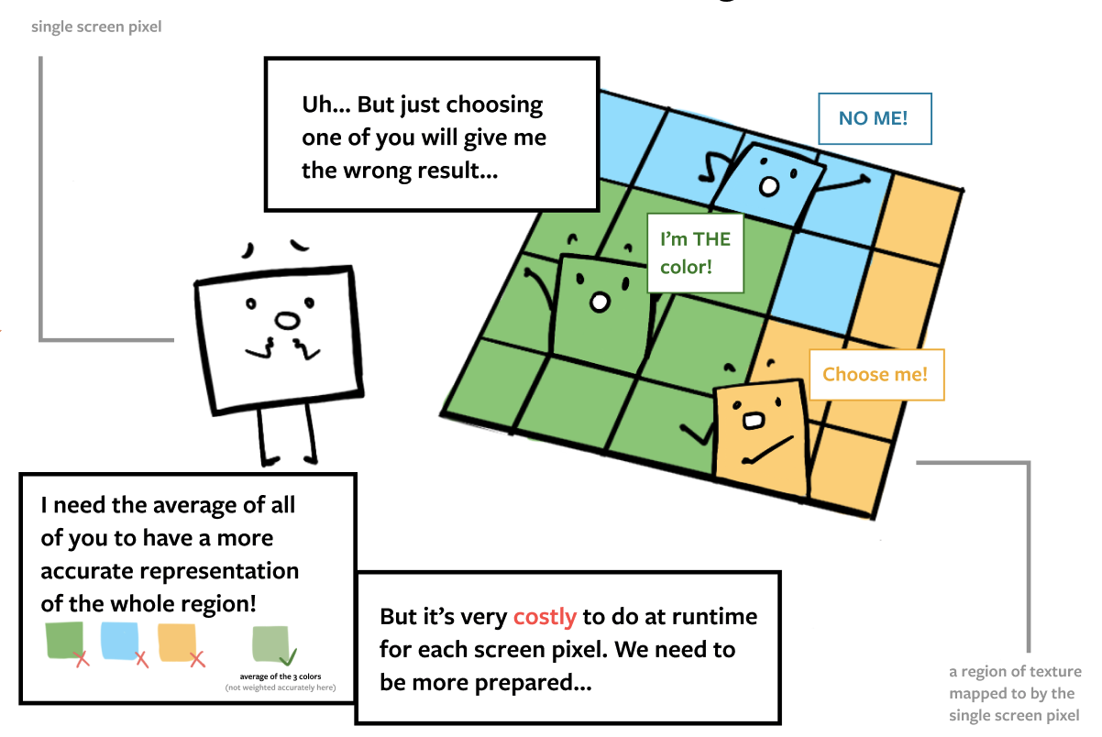
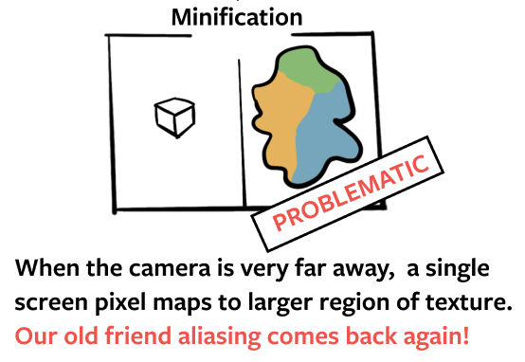
Task 7: MipMap Creation
Notes:
Let’s generate some MIPMAP to further combat our good old friend aliasing. We need to generate MIPMAP when there is minification, which is when the camera is very far away, a single screen pixel maps to a larger region of texture. As a a result, the pixel has no idea which color it should choose from to get an accurate representation of that region of texture. Choosing any single one texel of the texture will cause aliasing, since as you can see here, we need the average of all the texels in that region. This is very very costly to do in run-time, so we want to precompute them.

Slide 40
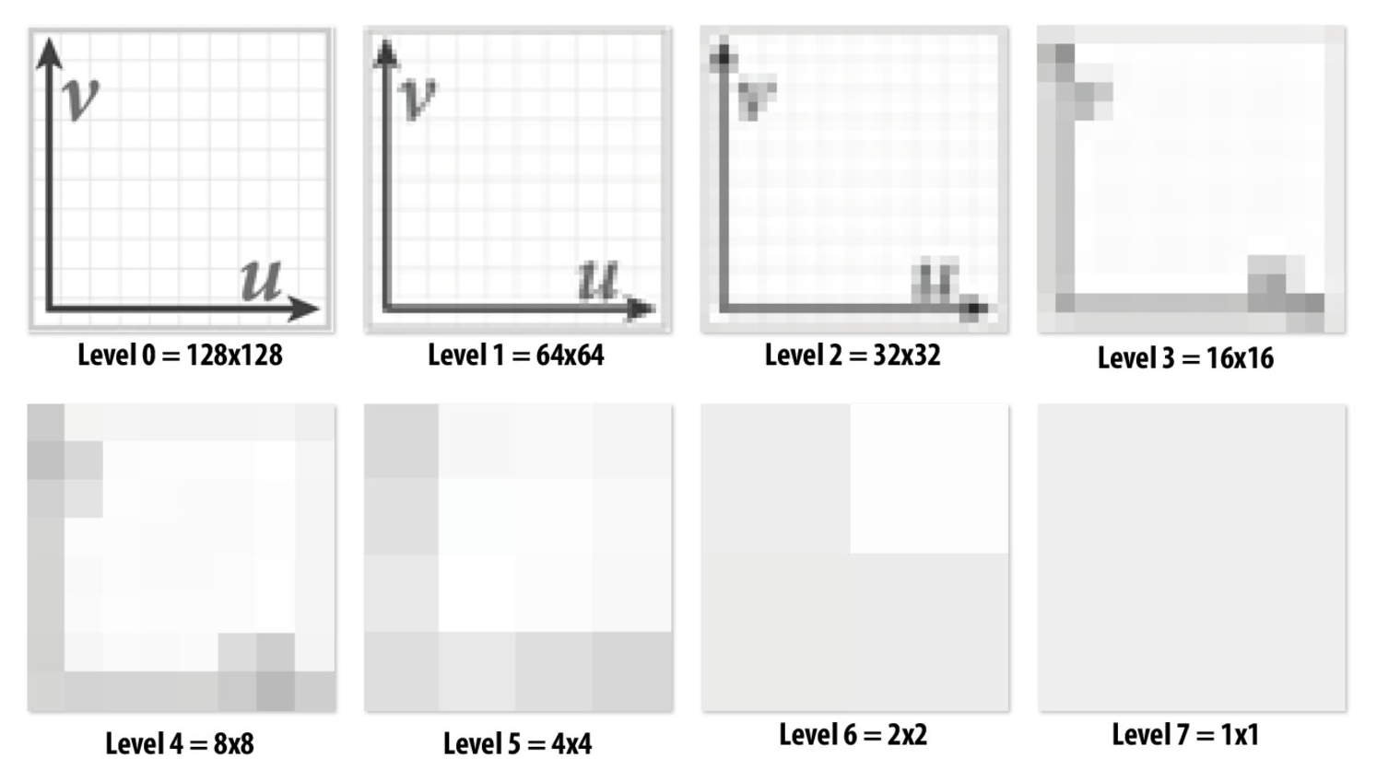

Task 7a: MipMap Creation
The mipmap data structure will be an array of vectors, where the vector holds the rgba data of the texture at that level.
At Level i+1, every 4 pixels from Level i are averaged together.
If Level i is NxN, what is the size of Level i+1?
Implement:
void generate_mips(Texture& tex,
int startLevel)
tex.mipmap is an array of vectors.
startLevel is where in the array you need to start allocating mipMaps.
Notes:
The first part of task 7 is generating the MipMap. A good resource for this task is Lecture 7 Perspective Projection and Texture Mapping.
We want to generate many different levels of MIPMAP so we are ready at runtime.At Level i+1, every 4 pixels from Level i are averaged together. The function you will need to implement is generate_mips, which takes in a texture, and an int specifying the starting level.
So what you want to do when generating mipmaps is
Allocate memory for sublevels, i.e. calling resize on tex.mipmap with the right number of levels
Then, you want to initialize the vectors for each level’s texels.
Finally, you should compute each level’s texels by averaging the corresponding 4 pixels from the level below.
By the time you exit the function, you should have a collection of mipmaps ready to go.

Slide 41
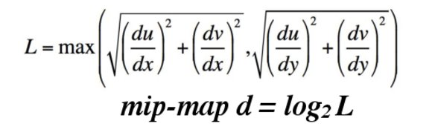
Task 7b: Trilinear FIltering
Implement:
You may call bilinear in your trilinear function.
Make sure to use trilinear in rasterize_image();
void sample_trilinear(Texture& tex,
float u, float v,
float u_scale,
float v_scale);
d will be a float, so we sample from textures floor(d) and ceil(d).
Level ceil(d)
primitive
dy
Bilerp (3 Lerps)
dx
(1 Lerp)
texture
Level floor(d)
Bilerp (3 Lerps)
dv
du
Notes:
The second part of task 7 involves using the MipMaps you generated to get better values for each sample. We will be doing trilinear filtering, and a hint is, you can use sample_bilinear in your sample_trilinear function. Don’t forget to call trilinear in rasterize_image so you are actually doing trilinear sampling.
So what you need to do is step 1, calculate your mip-map level d by following the formulas here, Note that we are assuming no rotations, so we can easily calculate du/dx, dv/dx, du/dy and dv/dy. Then you want to bilinearly interpolate values at that specific (u, v) coordinate for both the MipMap at ceiling of d and floor of d. Hint, you can call sample bilinear. Then, you do another lerp with those two values, therefore summing up to 3 lerps in total.
Slide 57 - du/dx, dv/dx, du/dy, dv/dy, your code will end up with two of them being 0.
Note that we are assuming no rotations, so we can easily calculate du/dx, dv/dx, du/dy and dv/dy.

Slide 42
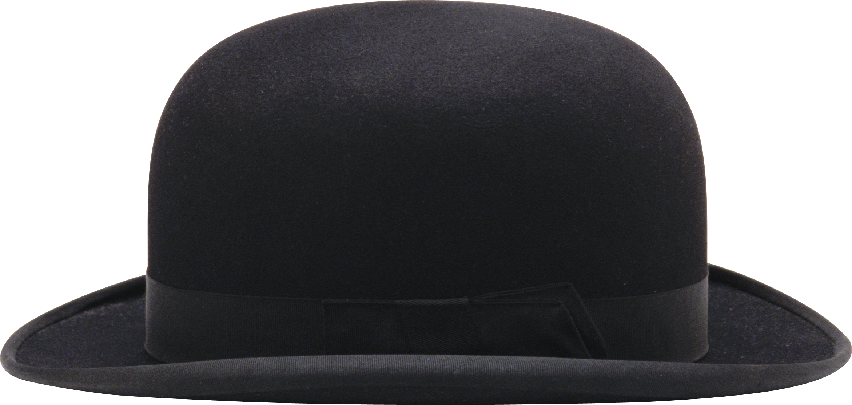

Task 8: Alpha Composing
“You will need to modify the parts of the code which write to the supersample buffer” - writeup
Find all locations where your supersample buffer is written to, and add alpha composing. Make sure to alpha compose with the original canvas too!
Er, Eg, Eb
Ea
Cr, Cg, Cb
Ca
Rr, Rg, Rb
Ra
Element color value
Element alpha value
Canvas color value
Canvas alpha value
Result color value
Result alpha value
Ra
Rr
Rg
Rb
= 1 - (1 - Ea) * (1 - Ca)
= (1 - Ea) * Cr + (Ea) * Er
= (1 - Ea) * Cg + (Ea) * Eg
= (1 - Ea) * Cb + (Ea) * Eb
Notes:
Lecture 8 - Depth and Transparency
Implementing simple alpha blending - update everywhere u write to the supersample buffer
Congratulations on making it to the last coding task for your first graphics assignment. We are so very proud of you! Task 8 should be rather straightforward both conceptually and implementation wise. What you need to do is find all locations where you are writing to your supersample buffer, and update how you store the color values. Before we just directly wrote whatever the current primitive’s color is into the buffer, but now we have layers of colors that we need to mix together, hence we want to be doing alpha composing. You want to first find these corresponding values for the current element and current canvas. Then you can follow these formulas here to properly compose the colors to get the result rgba.

Slide 43
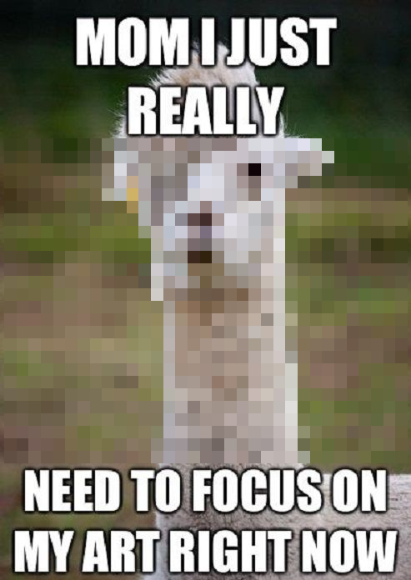

Task 9: Draw Something!
No AA
6x AA
Best original work (not including copyrighted materials) will have their work included in the DrawSVG svg pack for next semester.
Notes:
Yay! You are almost done! For the last task, we just want you to have fun and feel proud of the wonderful rasterizer you have created. We might be giving out some bonus points for the ones that are very creative so spend some time on this if you have the time.

Slide 44
Congrats! You finished! We are so proud of u <3

